Slide 1




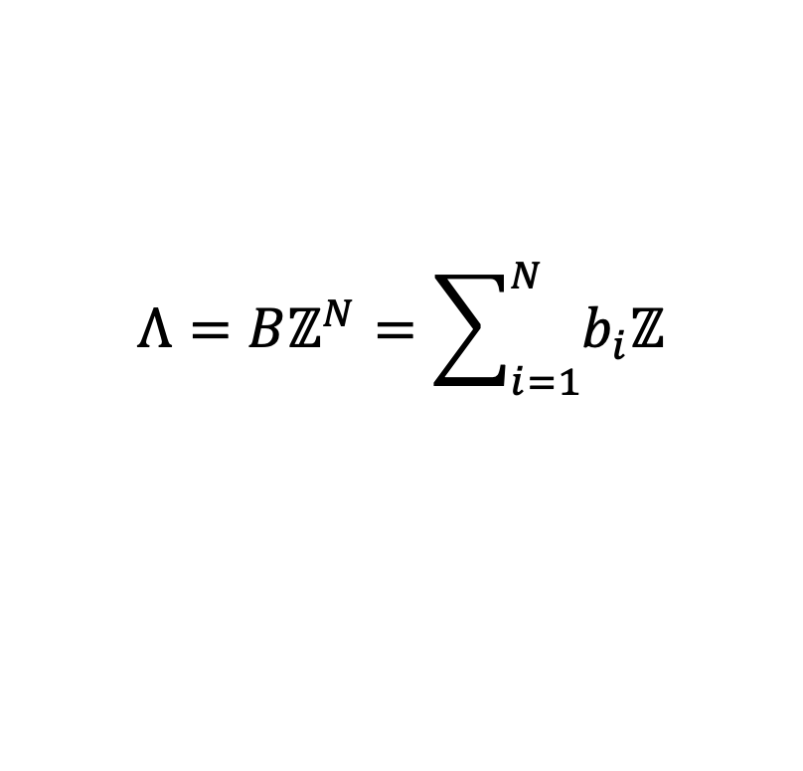
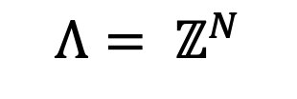
$$b_{1}$$
$$b_{2}$$
$$Λ=Bℤ^{N}=\sum_{i=1}^{N}{b_{i}ℤ}$$
$$Λ= ℤ^{N}$$

Slide 2




$$a_{1}$$
$$b_{1}$$
$$b_{2}$$
$$a_{2}$$
$$Λ=\sum_{i=1}^{2}{a_{i}ℤ}$$
$$Λ=\sum_{i=1}^{2}{b_{i}ℤ}$$

Slide 3
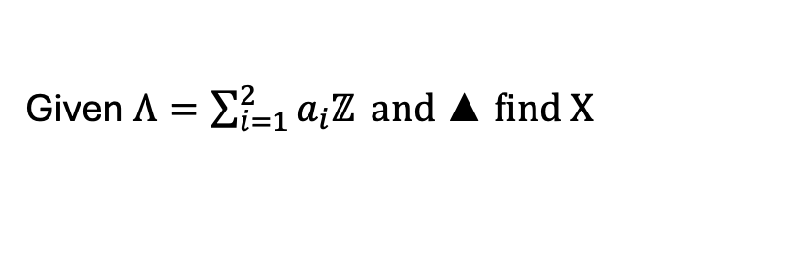



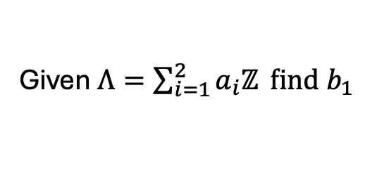


Shortest Vector Problem
$$Closest Vector Problem$$
$$X$$
$$a_{1}$$
$$a_{1}$$
$$b_{1}$$
$$a_{2}$$
$$a_{2}$$
Given $Λ=\sum_{i=1}^{2}{a_{i}ℤ} find b_{1}$
Given $Λ=\sum_{i=1}^{2}{a_{i}ℤ} and▲find X$

Slide 4
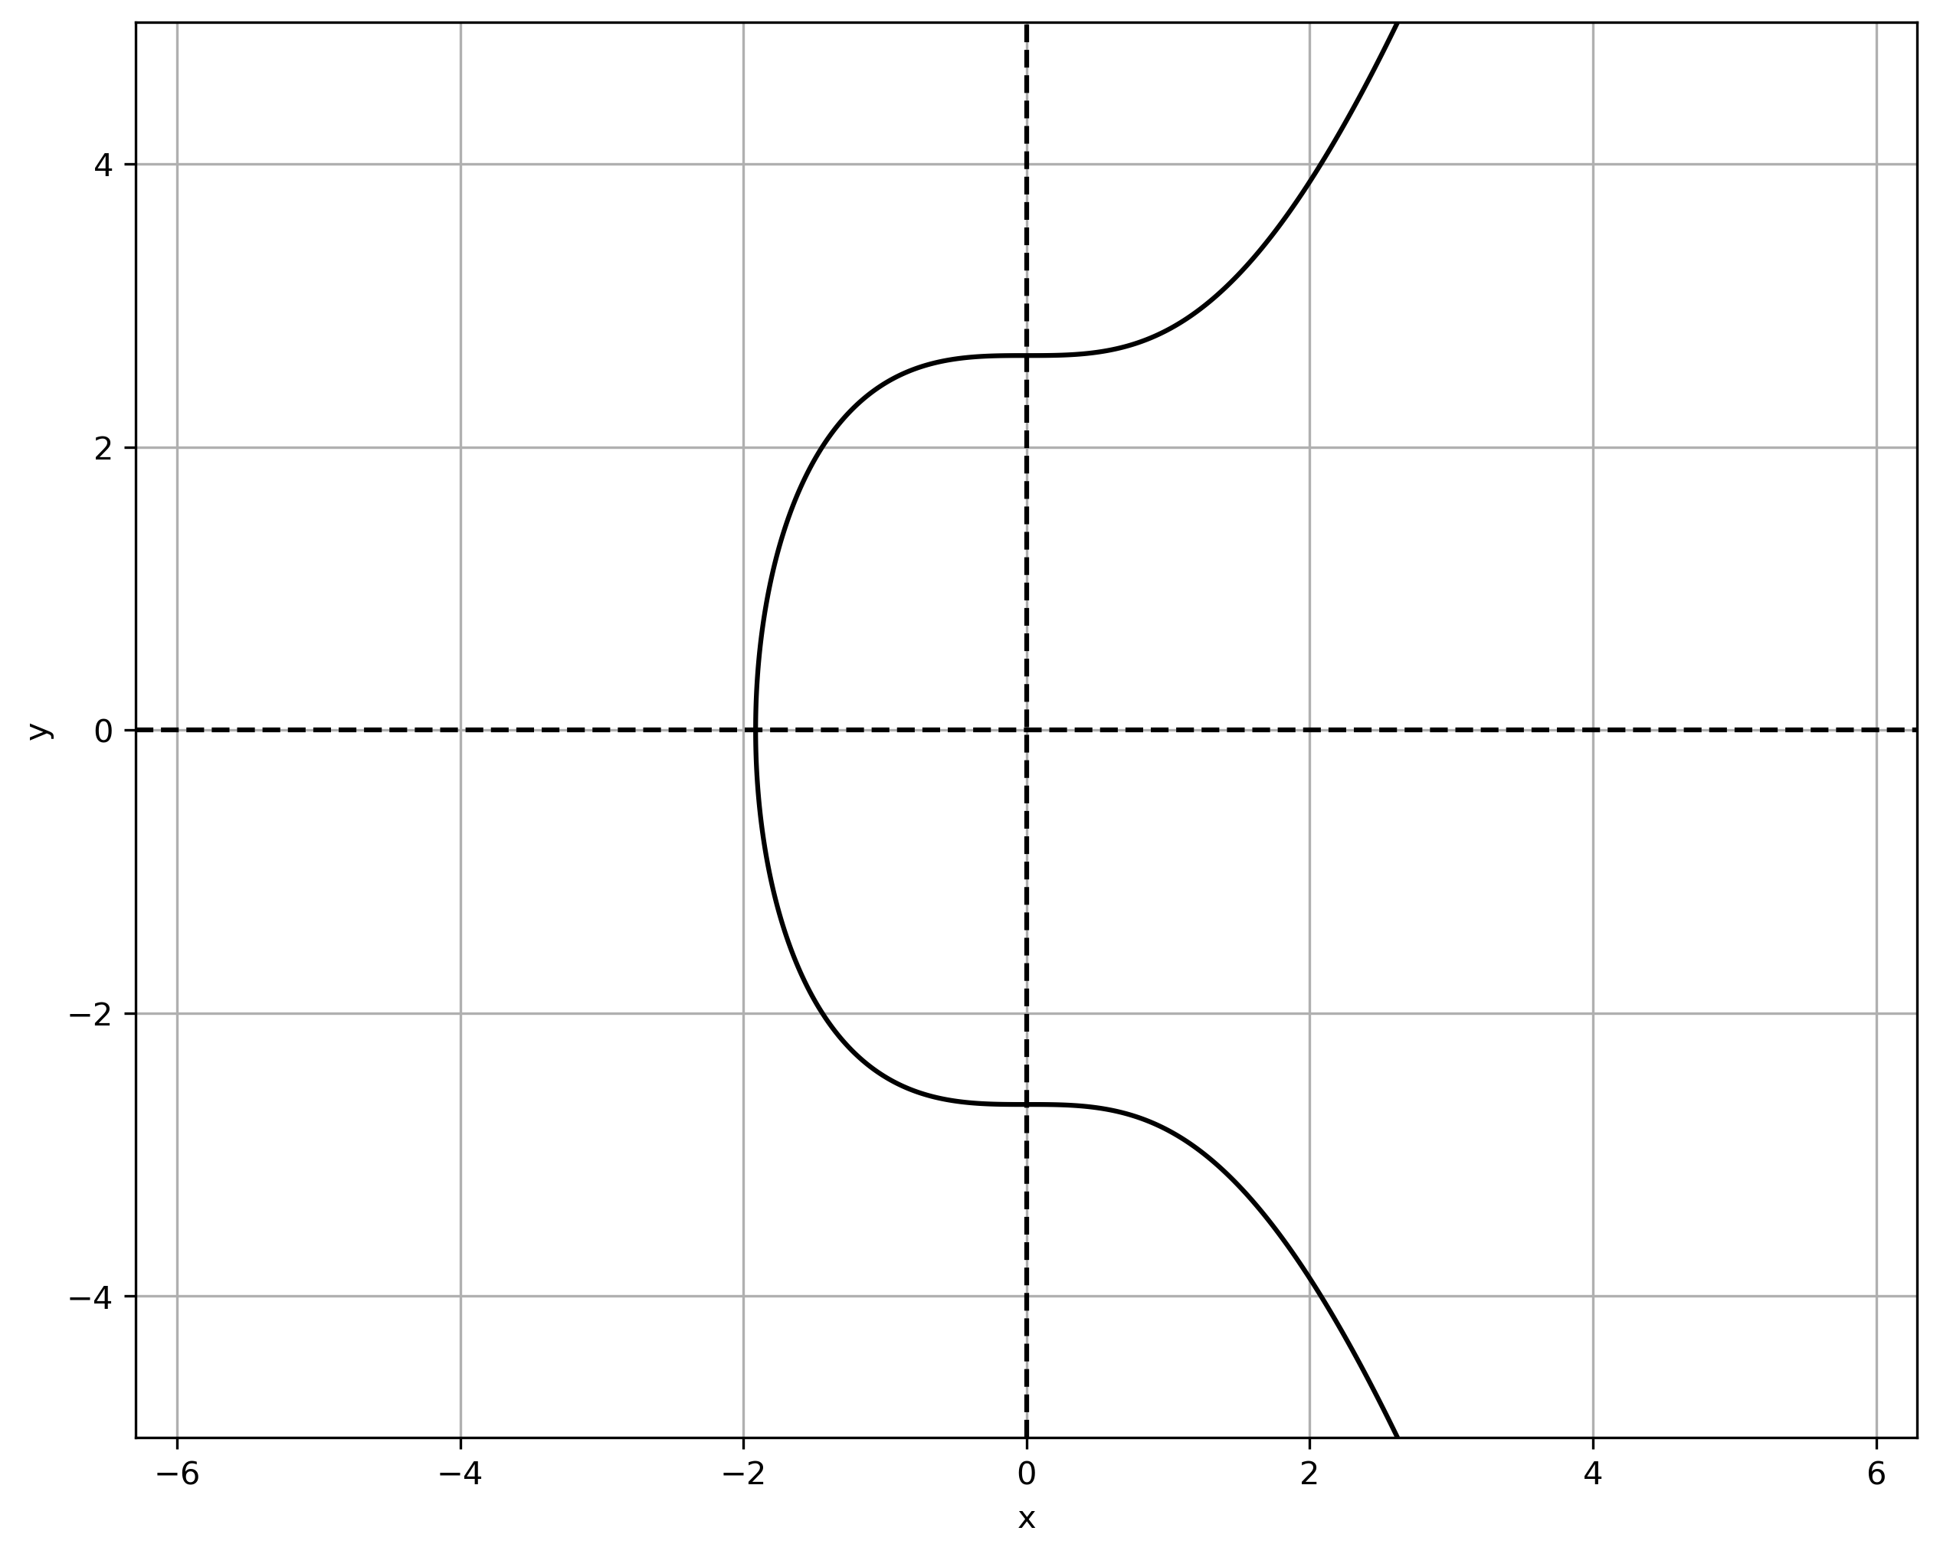
R
Q
P
P
P + Q = -R

Slide 5
P
P + P = -R
R

Slide 6
Node
P2P Network
Beacon Node API
Consensus Layer
Ethereum
User
Web3 Library
Engine API
P2P Network
Execution Layer
JSON-RPC API

Slide 7

Block
Builder
Genesis Block
Block
N - 1
Block N
Header
Header
Header
Transactions
Transactions
Transactions
Transaction Mempool
Txn Signature
Verification
Txn 1
Txn …
Txn N-2
Txn 2
Txn …
Txn N-1
Txn 3
Txn …
Txn N

Slide 8
Off-Chain
On-Chain
Initiate Transaction
Sender:
Secret Key
Public Key
Transaction Mempool
Txn 1
Transaction Object
from: 0xSender
to: 0xReceiver
Value: 1Eth
Other data
Txn …
Txn N-2
Txn 2
Txn …
Txn N-1
Txn 3
Txn …
Txn N
RLP-Encoding
Sign_Transaction(
message,
secret key) → Signature
Message
Transaction to Send
Transaction Object Data from before
Signature
Ethereum
RLP-Encoding
RLP-Encoded Signed Transaction
Ethereum Node

Slide 9

On-Chain
Off-Chain
Victim
Victim Secret Key (k_{V})
Solve ECDLP with
Quantum Computer:
K_{V} = k_{V}G
Transaction Message (M_{V})
Transaction Signature (S_{V})
Stored within
Obtained Victim’s
Secret Key
Block N
Stored
within
Request
M_{V}, S_{v}
Ethereum Node
Hacker
Victim Public Key (K_{V})
Header
Public Key Recovery
(M_{V},S_{V}) → K_{V}
Transactions

Slide 10
Block N-2
Block N-1
Block N
Confirm Block using a
Consensus Mechanism
Proposed
Block N+1
Block N-2
Hash(Block N-3)
Hash(Block N-2)
Transactions
Other Data
Block N-1
Hash(Block N-2)
Hash(Block N-1)
Transactions
Other Data
Block N
Hash(Block N-1)
Hash(Block N)
Transactions
Other Data

Slide 11
Non-Secure
Communication
Channel
Sender
Seed or
RNG
Key Generation
Secret Key
Message
1. Public Key
2. Signature
3. Message
One way Function
Signature
Generation
Verifier
Public Key
Signature
Signature
Verification

